Slide 1
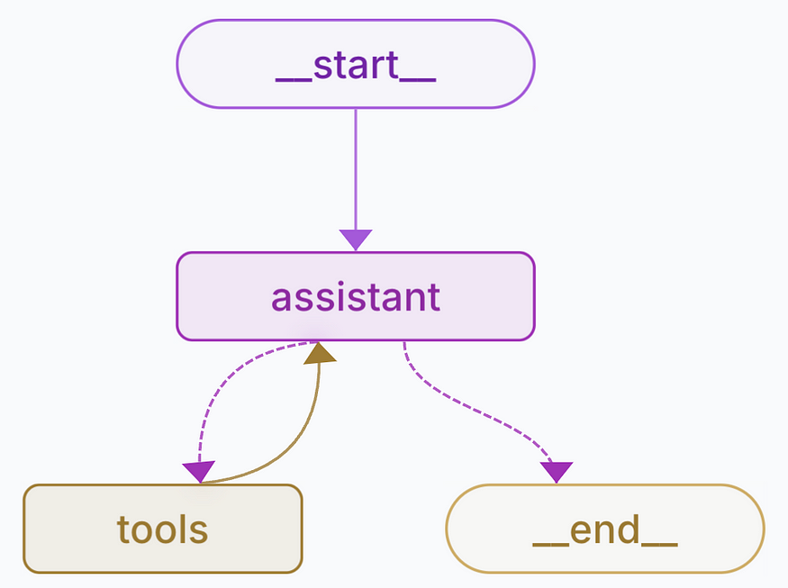

Building AI Agents with LangGraph
LLM
Explores AI agents and their components. We will examine multi-agent systems and the role of LangGraph.
by Mirza Minhaz Baig
Notes:
This presentation explores the concept of AI agents and their key components We'll examine multi-agent systems, where multiple agents work together to solve a problem The example shows a system with a controller agent and two worker agents - a coder and a tester These agents communicate and collaborate until they're satisfied with the code, then pass it to the user Multi-agent systems offer benefits like parallel task completion and error reduction through feedback Agents can be assembled in various configurations, and an individual agent is made up of different components In the next section, we'll dive deeper into an agent's profile, actions, memory, and planning capabilities

Slide 2
⚠️ Workshop Disclaimer
This workshop is intended purely for learning purposes. While we’ll explore how to build AI agents and prototypes, please note:
Only use compliant tools and technologies approved by Synchrony if you're testing or building anything on Synchrony devices.
Do not use non-compliant or publicly available internet tools (e.g., unofficial APIs, external LLMs) on Synchrony devices.
If you wish to explore such tools, please do so on your personal systems, outside of Synchrony’s environment.

Slide 3
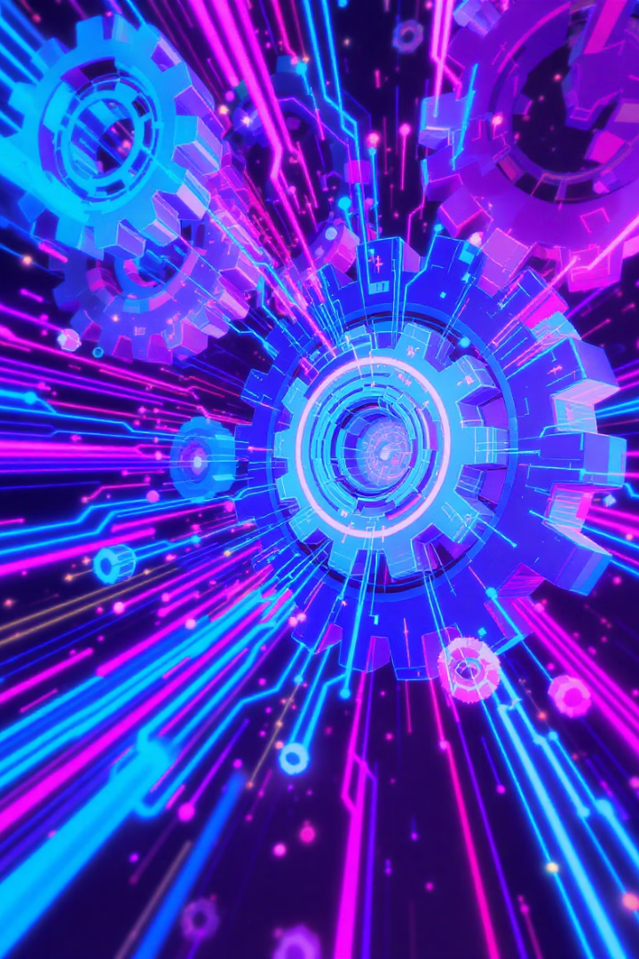



Workshop Highlights
AI Agents
AI agents provide modular, intelligent automation. They handle tasks autonomously.
Multi-Agent Systems
Multi-agent systems enable scalable collaboration. Agents work together efficiently.
LangGraph
LangGraph bridges AI agents to real-world workflows. Hands-On with Text Analyzer Agent.

Slide 4
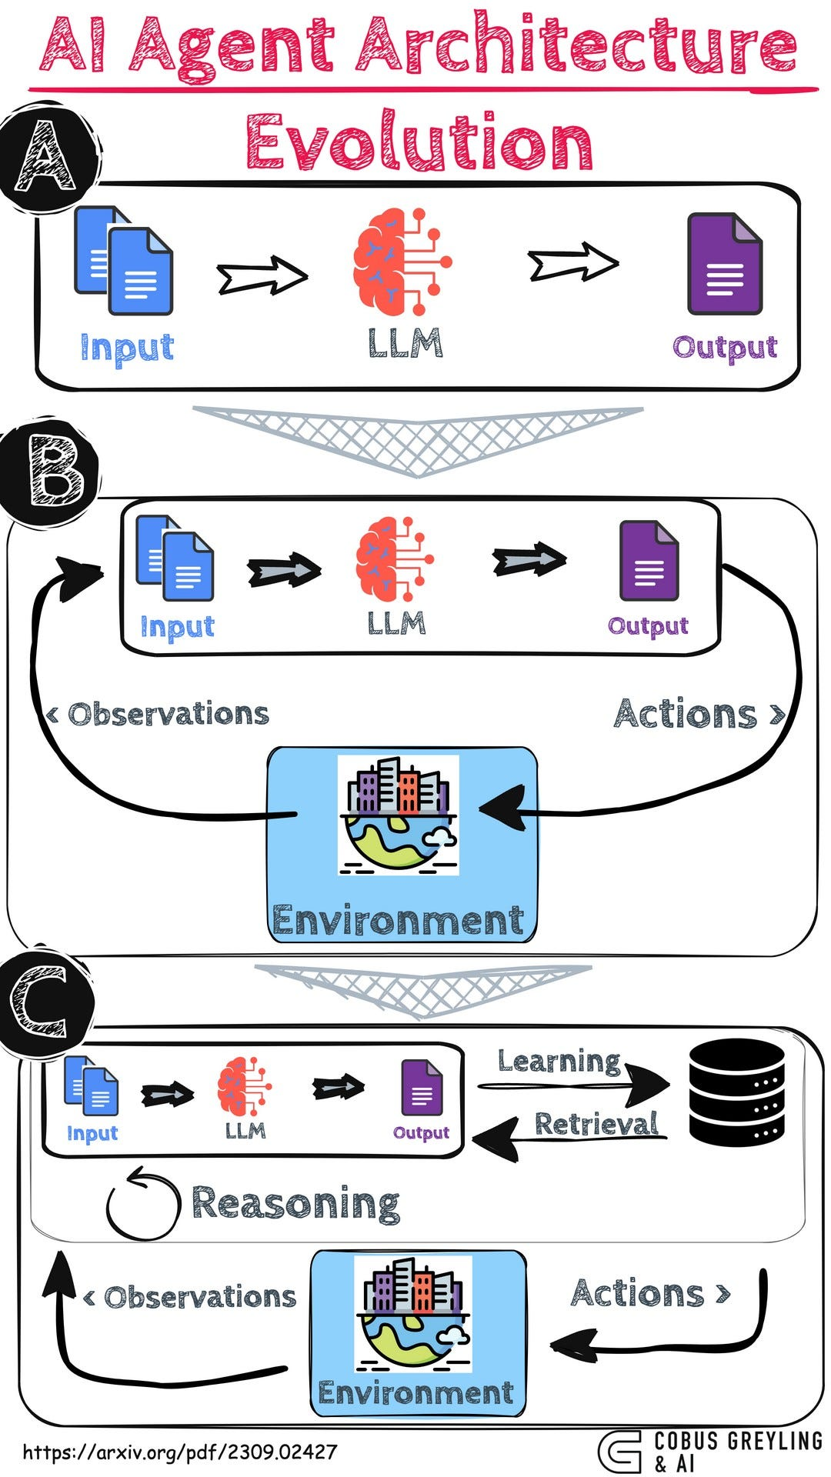



The Evolution of AI Interfaces
Prompt Engineering Limitations
Traditional prompt engineering struggles with long, iterative workflows. It cannot manage complex, multi-step processes efficiently.
Rise of Agent Frameworks
This led to new agent frameworks like AutoGPT. These frameworks manage state and orchestrate tasks. They enable more dynamic interactions.
AI Interfaces
AI is moving to natural language interactions. Agents interact with applications and data. They use AI interfaces for seamless communication.

Slide 5
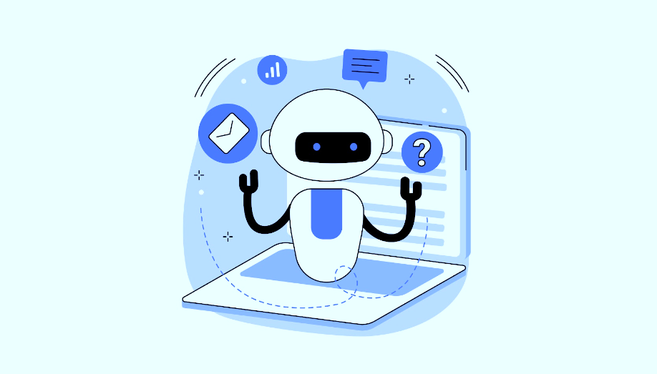
What Are AI Agents and Why Do They Matter?
AI agents are intelligent systems that can take action or make decisions to achieve specific goals—often working with or on behalf of a user. You’ve likely already interacted with examples like ChatGPT, AutoGPT, or virtual assistants in customer service.
So, why are AI agents useful? They help automate complex tasks, reduce repetitive manual work, and can reason, plan, and adapt using large language models (LLMs).
At the core, every AI agent has key components:
A profile or persona that shapes its role and behavior,
Actions it can take,
Memory and knowledge to retain context,
Reasoning and evaluation to think through tasks, and
Planning and feedback to refine and improve its performance.
Notes:
AI agents are complex systems composed of multiple components that work together to help the agent achieve its goals The key components of an AI agent include: The agent's profile and persona - the core of the agent Systems and functions that enhance the agent's capabilities These components can range from simple to highly complex, and work together to give the agent the tools it needs to complete its tasks For example, a text classification AI agent may have components like natural language processing, machine learning models, and knowledge bases to analyze and categorize text Using an AI agent can be beneficial because it can automate tasks, make decisions, and even create new goals - all with the power of its component systems Understanding the different parts that make up an AI agent is key to designing effective and capable agents

Slide 6
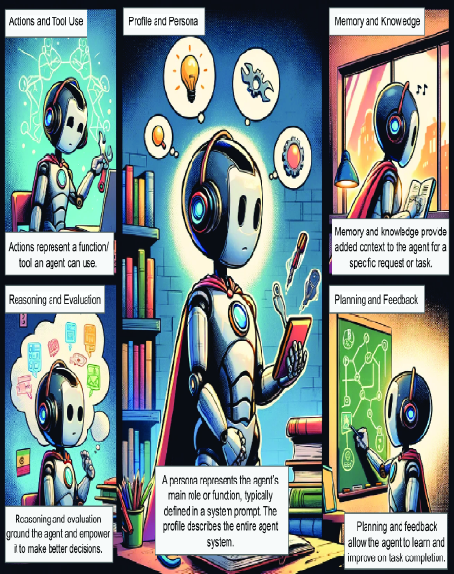
The main components of a single-agent system (image
generated through DALL-E 3)

Slide 7
Multi-Agent Systems: Collaborative AI
What Are Multi-Agent Systems?
Example Collaboration
Multiple AI agents work together. Each agent handles a specific task. A central controller coordinates their actions.
A coder agent writes the code. A tester agent creates unit tests. A controller coordinates their communication for effective workflow.

Slide 8
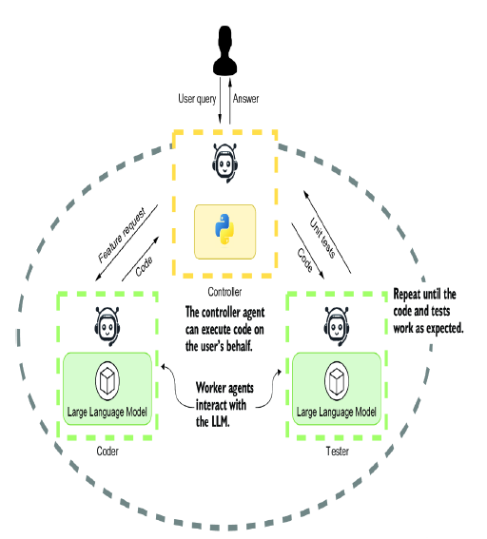
Multi-Agent Systems: A Self-Healing Codebase

Slide 9








Introducing LangGraph: Workflow Orchestration
What is LangGraph?
Why Use LangGraph?
LangGraph builds LLM-based workflows. It uses a state machine graph model. It supports multi-agent orchestration.
It simplifies multi-step agent workflows. It offers explicit control over state. It integrates seamlessly with LLMs and tools.
Example Workflow
LangGraph in Python
Classify input text. Extract named entities. Summarize the text. Visualize with a Mermaid diagram or flowchart.
Define a state with a Pydantic model. Add nodes as functions. Define edges for flow control. Compile into a runnable graph.

Slide 10
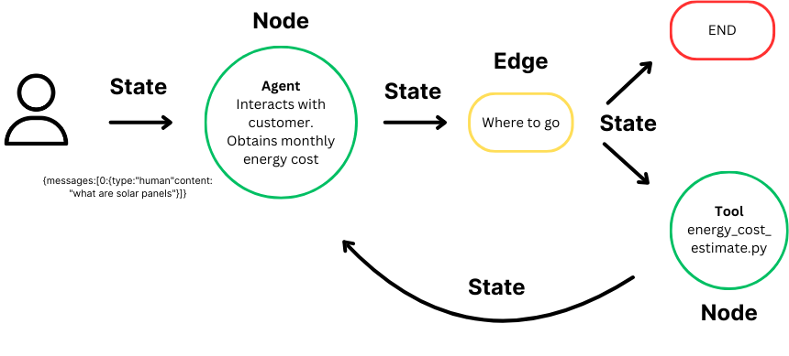
LangGraph for Agent Systems

Slide 11

Further Resources
LangGraph and Research
Agents
LangGraph Text Analyzer Agent App
Explore " https://www.pinecone.io/learn/langgraph-research-agent/” article by James Briggs
https://langgraph-analyzer-mirza.streamlit.app/
GitHub Repositories
Check out related GitHub projects: GPT-Agents and MMBCoder

